Slide 1

OPEN DEVELOPMENT CAMBODIA
Topic:
Making Digital Maps Using Free and Simple Mapping Applications

Slide 2
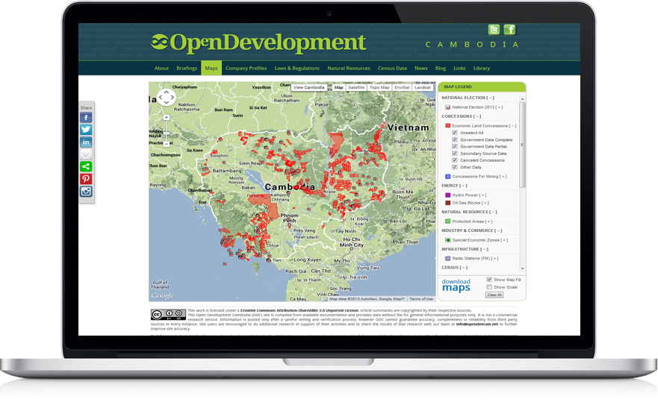

Map-making demo using Geocommons and QGIS
What are some of the free map-making software?
What do we need in order to create a digital map?
Why is map important?
What is map?

Slide 3
What is map?
Map is a visual representation of an area—a
  symbolic depiction highlighting relationships between elements of that space such as objects, regions, and themes.
https://maps.google.com/
http://maps.yahoo.com/
http://www.bing.com/maps/
http://www.openstreetmap.org/
https://www.google.com/maps/views/

Slide 4
Why Is Map Important ?
  Represents geography and topography
  Locates natural resources and developments
  Identifies size of particular areas
  Provides detailed information on specific locations
  Can be used to show changes in land uses and natural resources
  Saves time

Slide 5
What do we need in order to create a digital map?
Data
Map-making software
People who want to create map!

Slide 6
Data for mapping
There are two types of data that is used to generate maps
  Vector data
  Raster data

Slide 7
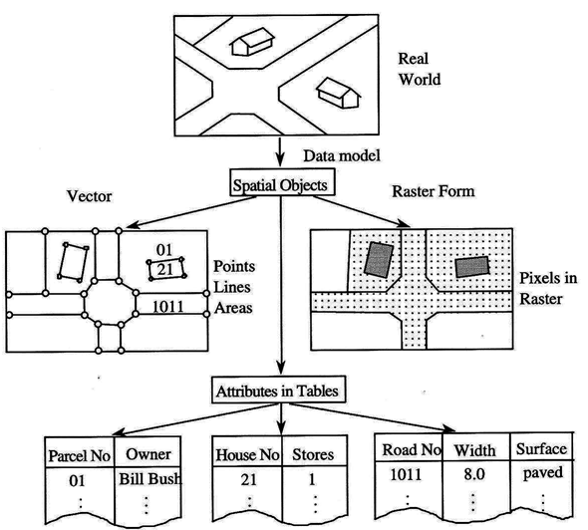
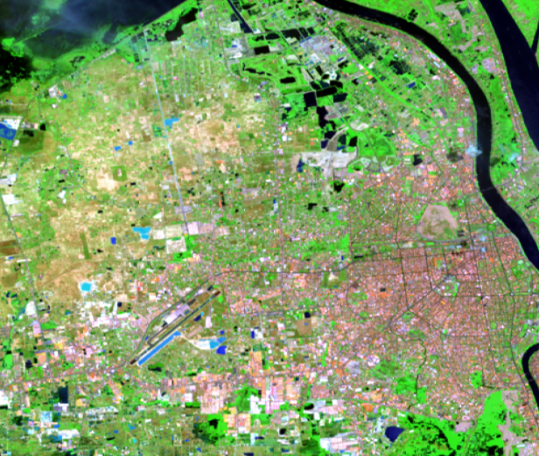
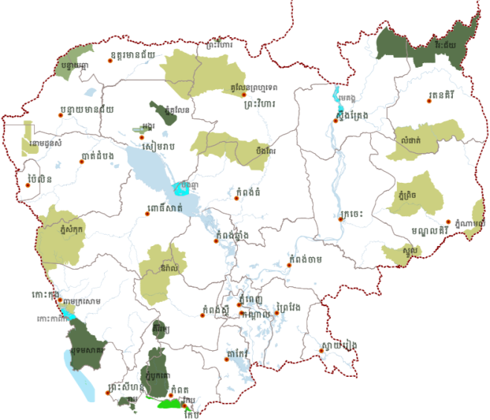
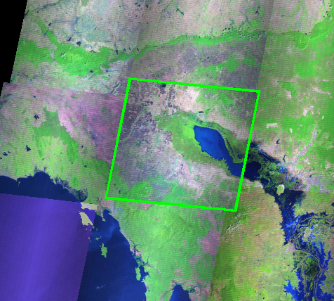
Geo-Spatial Data Concept

Slide 8
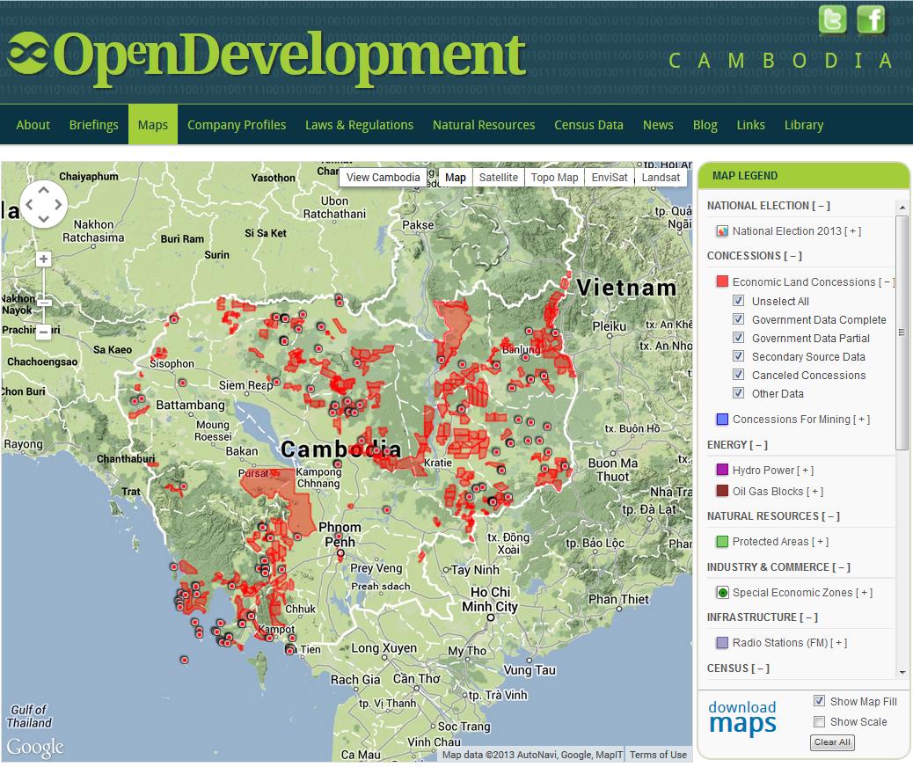
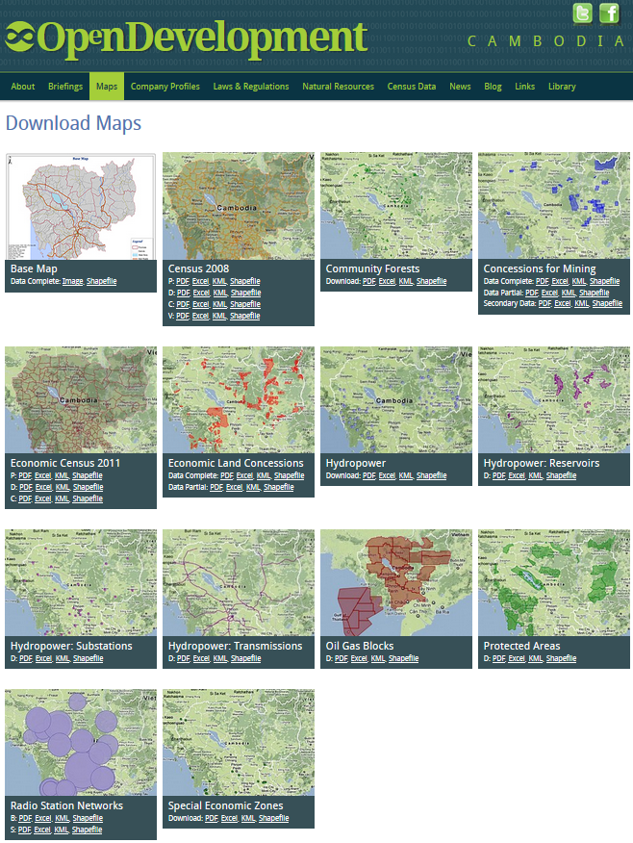
Examples of vector and raster data

Slide 9
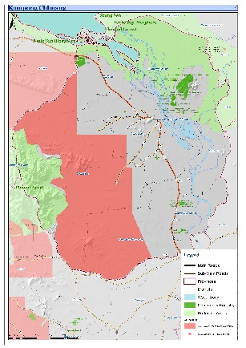
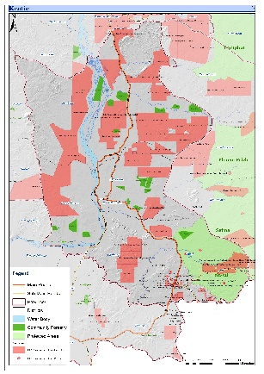
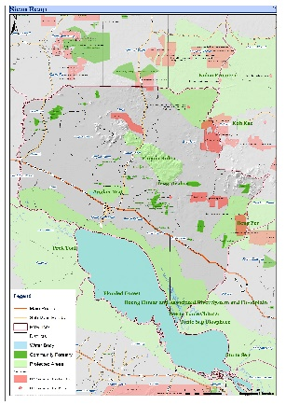
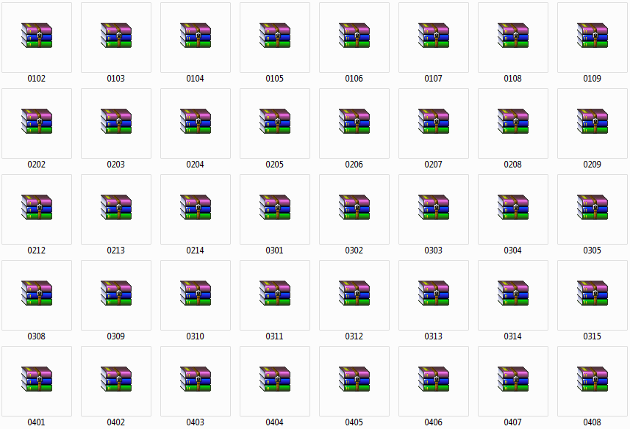
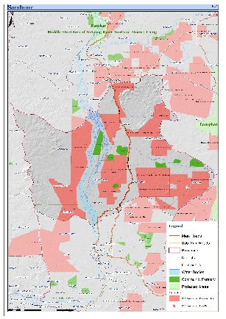
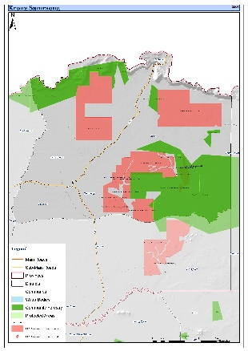
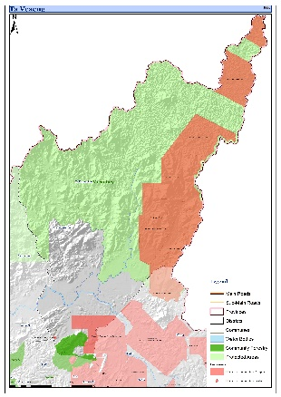
Demonstrate for general users
You can download Map Paper A3 from ODC site .
  http://www.opendevelopmentcambodia.net/base-map/
  Can be select both : Map paper and Shape file .

Slide 10
Free map-making software
There are a number of freely distributed map-making applications.
Some of the good map-making software include:
  QGIS
  Geocommons
  R
  Mango Map
  World Map

Slide 11
Map-making demo
Our team will demonstrate map-making techniques using two free applications
  QGIS and Geocommons

Slide 12
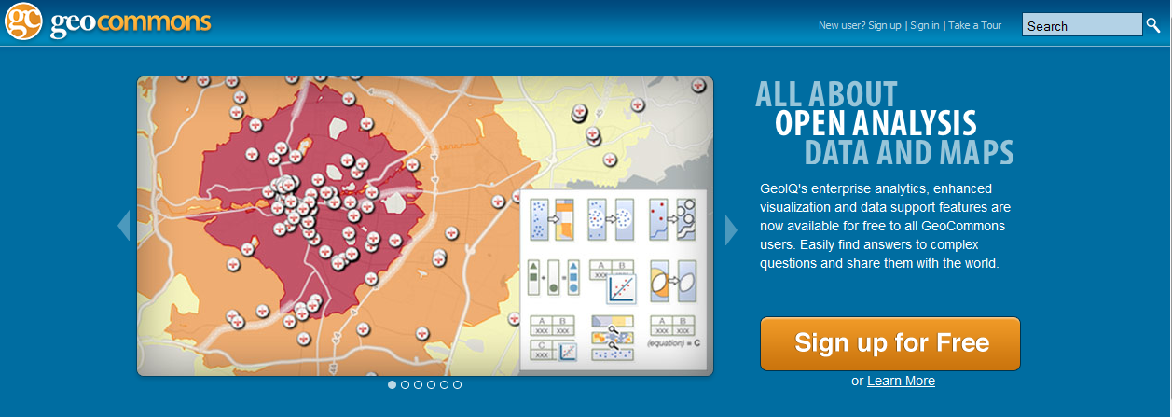
Demonstration for general users
  We are using ODC data on Geoserver as a sample for demonstration
  http://geocommons.com/. You can also upload your own data to Geocommons.

Slide 13
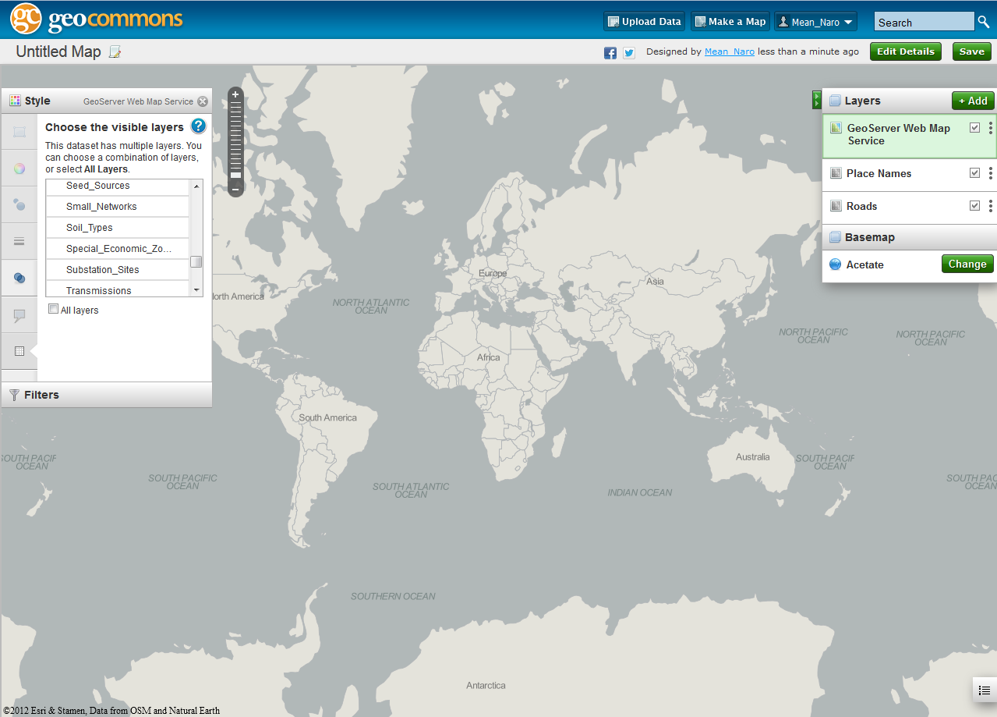
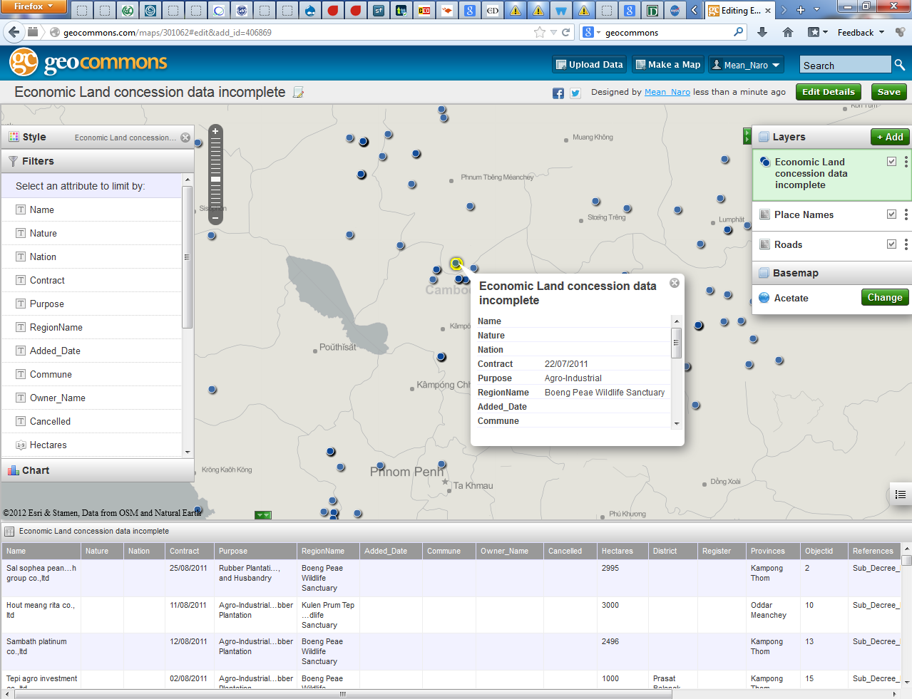
Demonstration for general users
Live on site

Slide 14
Demonstration for mappers
You can download spatial data from ODC website in two ways :
  ODC website /download pages : http://www.opendevelopmentcambodia.net/maps/downloads/
  ODC Geoserver “wms and wfs”
    wms : http://68.233.229.45:8080/geoserver/wms?
    wfs : http://68.233.229.45:8080/geoserver/wfs?

Slide 15
Demonstration for mappers
You can use some applications such as :
  Arc GIS 9.x , Arc GIS 10.x (Commercial software)
  Qgis (Open source software)
  Geocommons (webmap application)

Slide 16
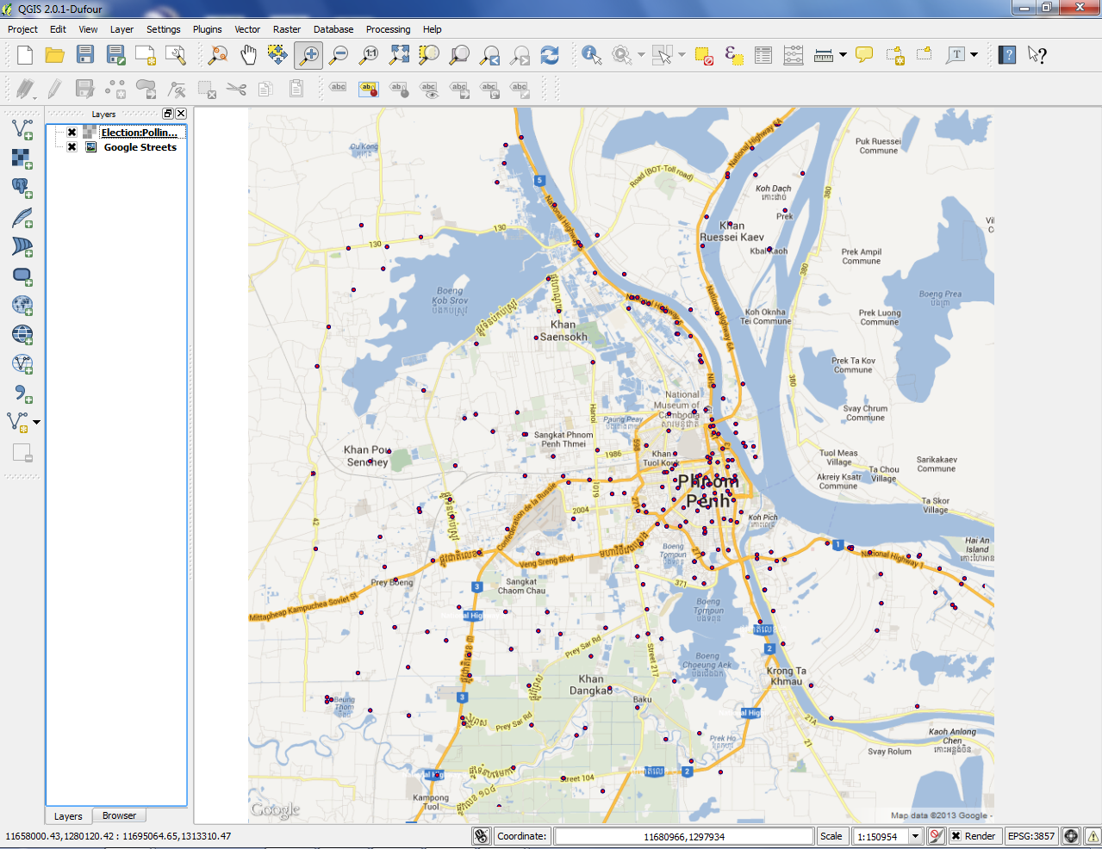
Example: Mapping polling stations in Phnom Penh in the 2013 National Elections
Show on the QGIS

Slide 17
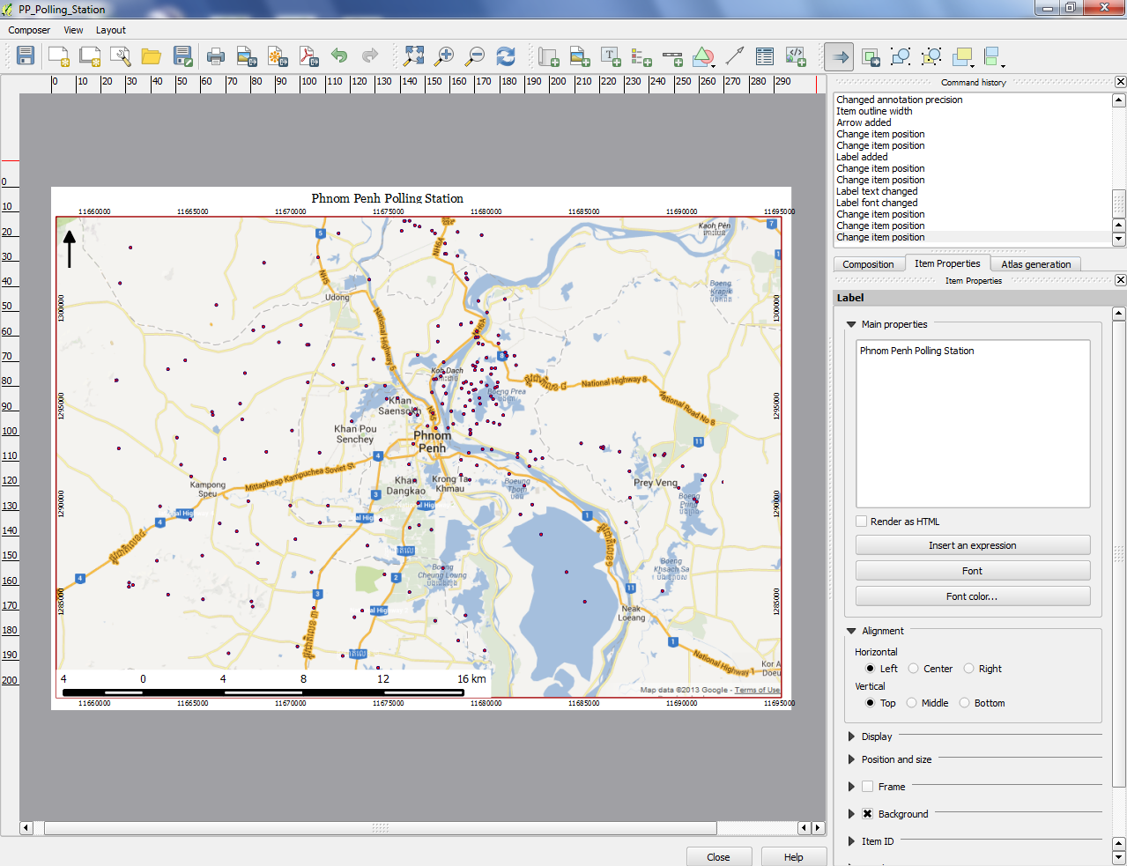
Composer map

Slide 18
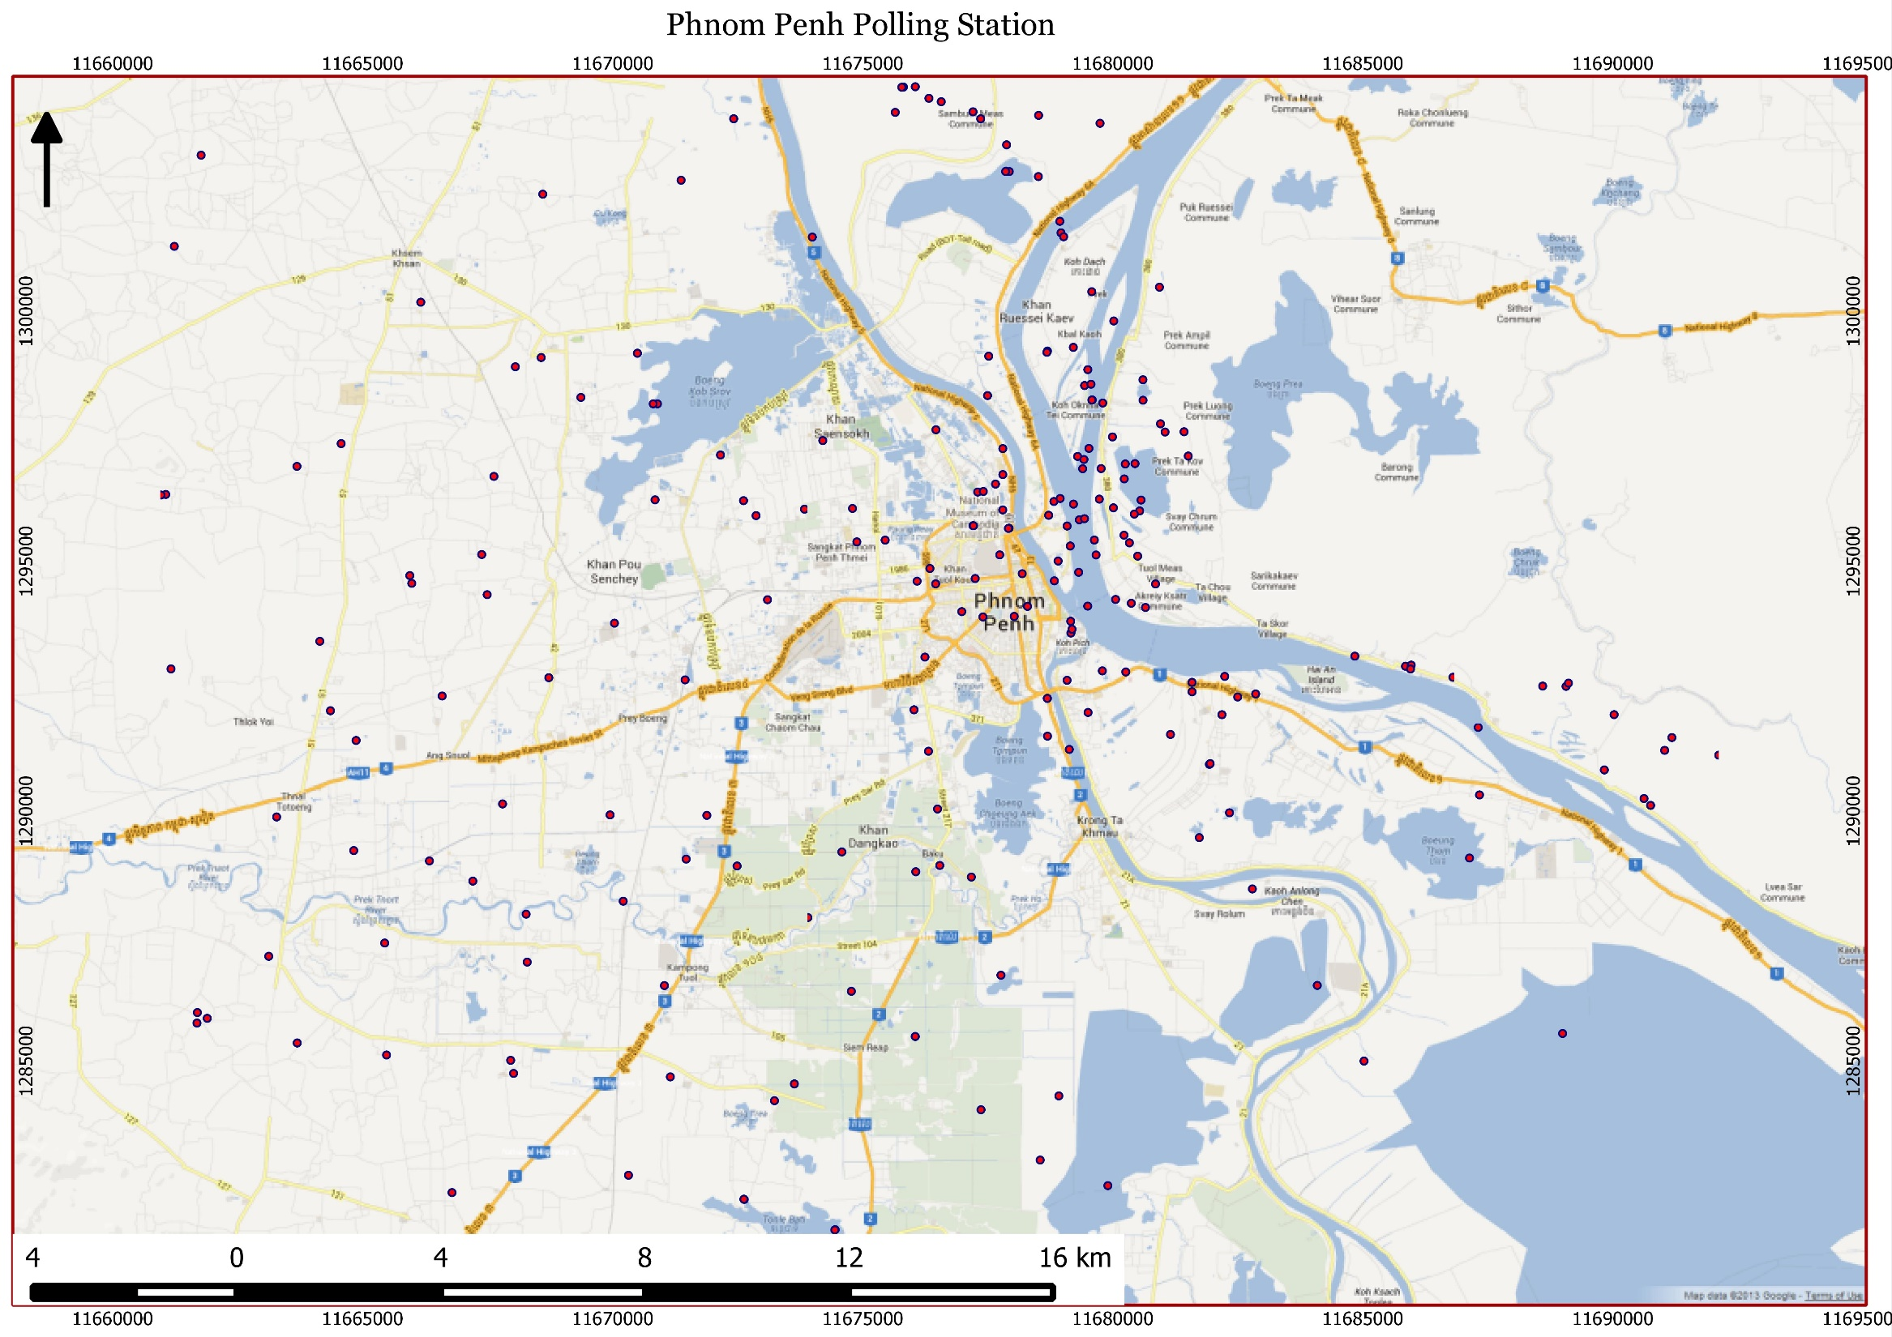
Output map layout

Slide 19
Thank you !

